Slide 1

“CREATING A WORLD CLASS TRANSPORTATION SYSTEM IN COLOMBO”
Amal S. Kumarage
amalk@uom.lk
4th November 2015

Slide 2
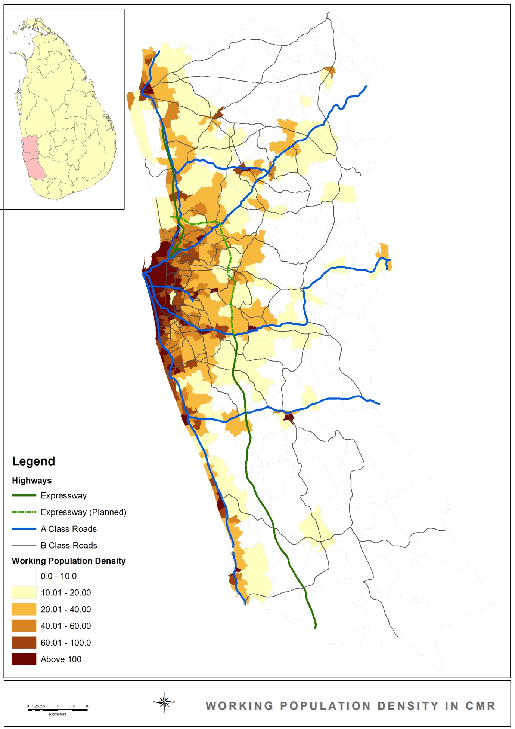
Transport Challenges for Colombo
To Provide….
Accessibility- 2 mn trips to city, 20 mn in CMR
Mobility – short trips (<5km) & speed (>20 km/hr)
Choice – of different modes for times/purposes
Livability –improves livable spaces
…and Is
Efficient-lower cost, <10% of GDP
Reliable– timeliness to build a lifestyle even on PT
Tech Savvy – can connect to modern technology

Slide 3
Understanding Current Issues
SYMPTOMS
Traffic Congestion
DIAGNOSIS
Income led vehicle ownership & use
Supply of Road Space cannot keep up
PROGNOSIS
Public Understanding
Integrate PT to Economic/Urban Policy
Transport has Poor Policy alignment
Loss of Urban Space
Deteriorating Quality of Life
High Investment on Transport
Deterioration in PT & Poor Public Image
Political Conviction
Increase Investment in HQ Urban PT

Slide 4
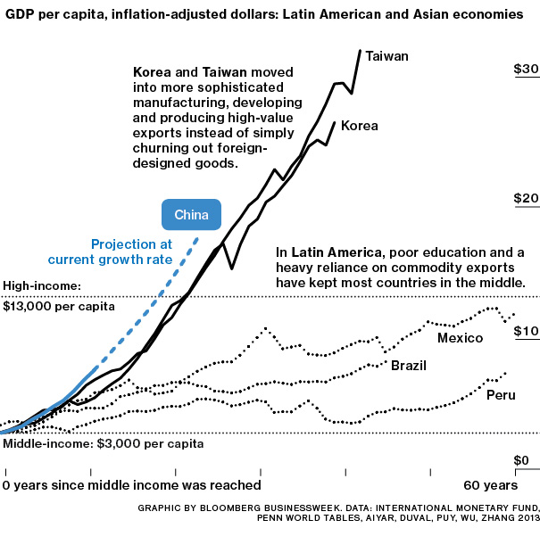
Caution!!: Middle Income Trap

Slide 5
Avoiding the Middle Income Trap
Increase in Personal Incomes
Lifestyle Change
Higher Demand for Road Space
Inability to Meet Capacity Required
External Losses Slows Economic Growth
Higher Mobility
Electronic Road Pricing
Vehicle Ownership Taxes
Public Investment
Public & Private Investment
Transport Policy
Public Transport INVESTMENT
Highway Building
Public Transport Subsidy
Highway Building

Slide 6
Urgent Steps Govt should take
STRATEGY: PT Priority (No choice)
PLAN: Transport MP (Available)
POLITICAL: Leadership (Champion Wanted)
FUNDING: Private & Public (Local & Foreign)
INSTITUTIONAL: Correct People & Processes

Slide 7
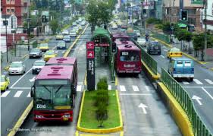
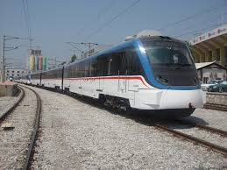
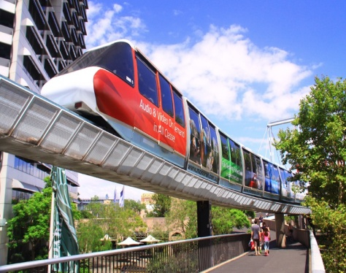
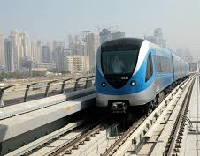
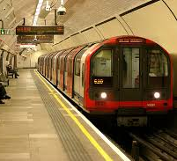
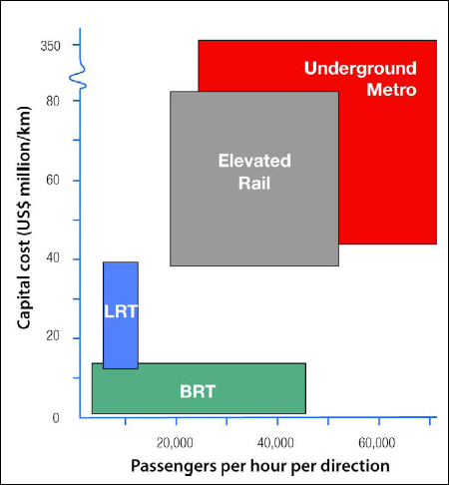
Elevated Highways
Monorail
Negombo Rd
Parliament Rd
Galle Rd
Kandy Rd
Trams
Suburban Rail
BRT
Modern Modes of Urban Transport
2015
2035
(1 lane/track)
Notes:
Pradeepa: Get a diagram with monorail and picture to match
35-50

Slide 8
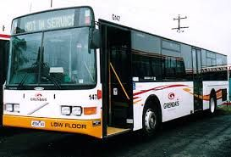
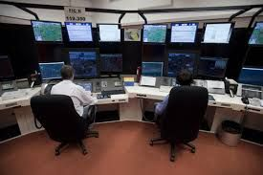
Bus System Modernization
Chaotic Now!→ Reform in Bus Operations
Not Modern →Introduction of Modern Buses
Compensate removal of extra buses (3,500)
Delays →New routes & schedules
Modern Passenger Conveniences→ Introduction of IT systems (fare collection, passenger information, bookings)
Speed→ Increase ‘non corridor’ D2D bus speed.
Cost→ Rs 173 bn (over 5 years)
EIRR → 86% !!!!

Slide 9
Corridor Improvements
BRT
Galle Road (Moratuwa
Kandy Road (stage-wise)
Express Bus
OCH (E2)
CKE (E3)
Bus Priority (major)
Parliament Road (Battaramulla)
High Level Road (Maharagama)
Bus Priority/BHLS (minor)
Low Level Road
Horana Road
Negombo Road

Slide 10
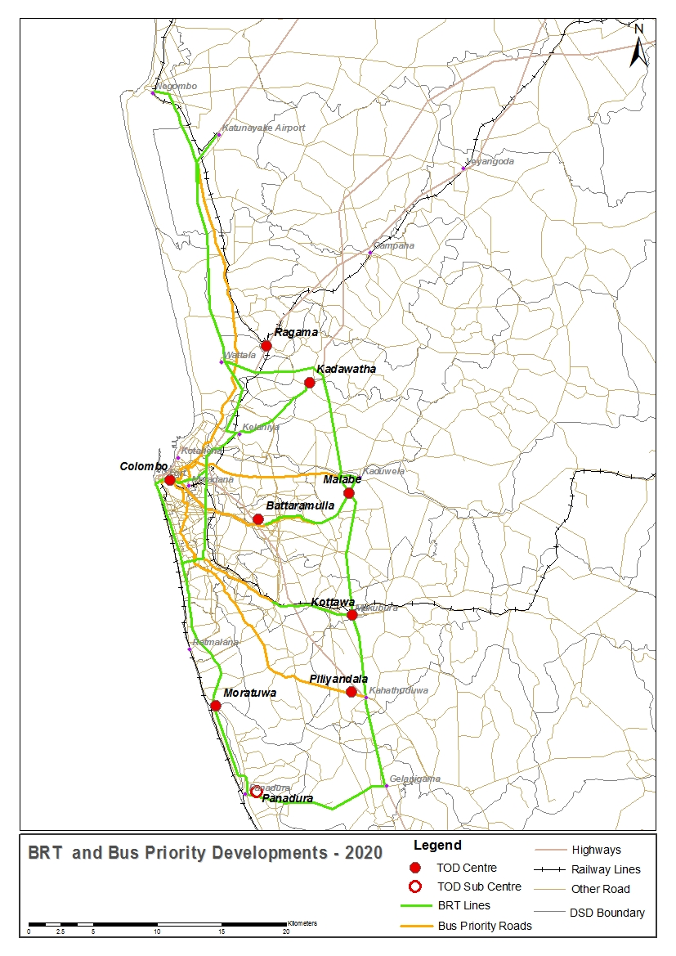
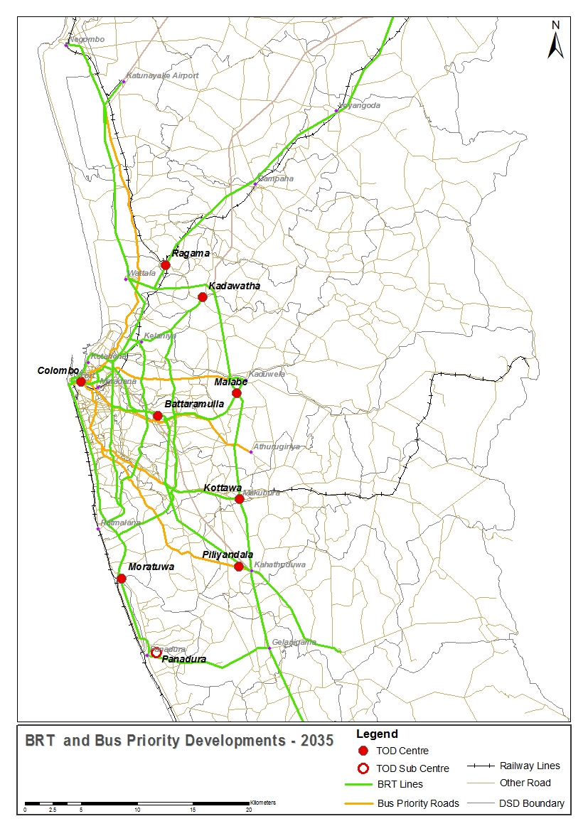
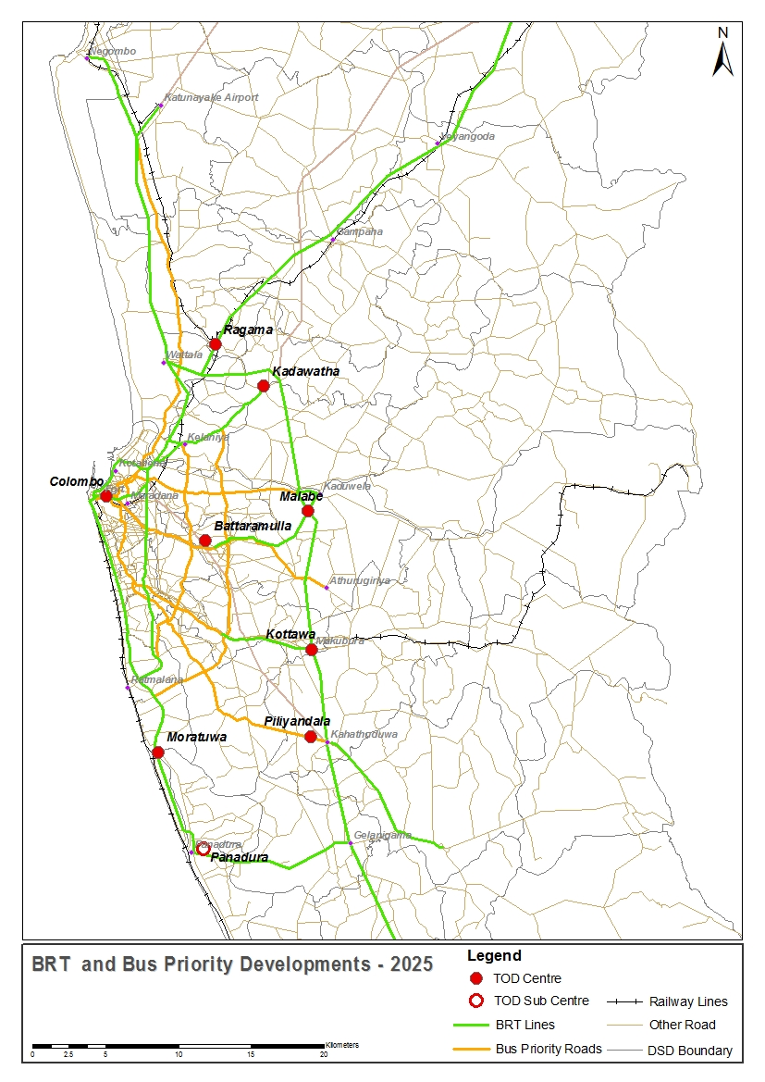
BRT and Bus Priority
2020
2025
2035

Slide 11
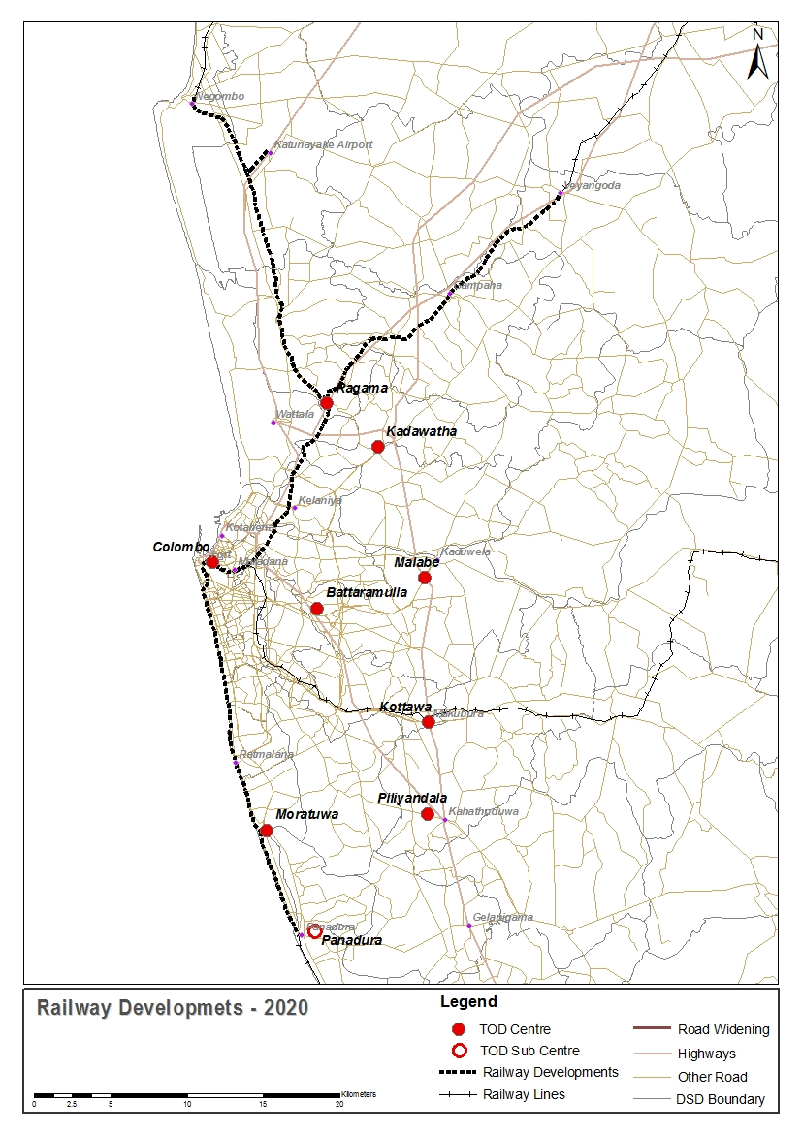
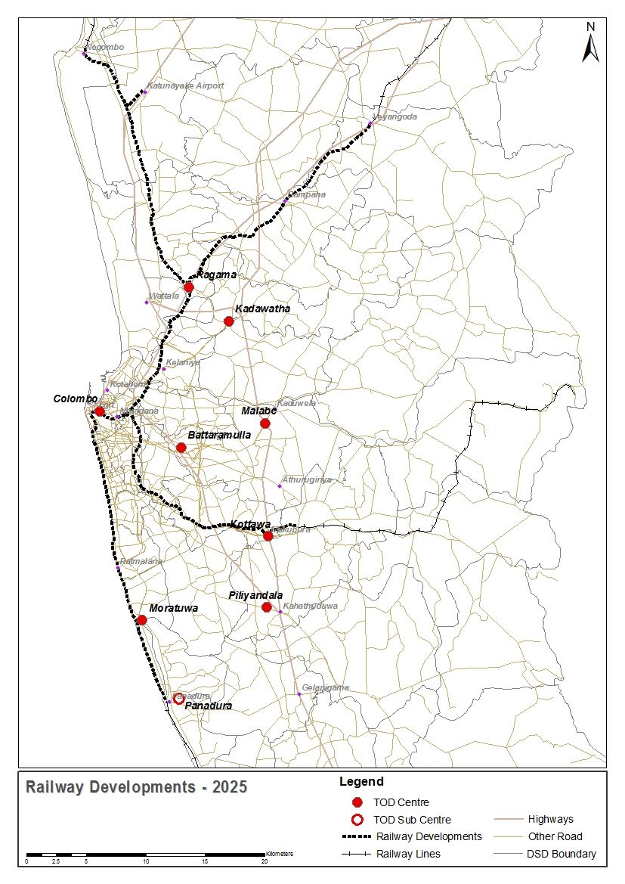
Railway
ICD?
Dompe
D
D
Kosgama
Padukka
1.Urban
Electrification
Higher Speed
Station Dev.
Higher Frequency
Improve Access
2.Freight
3.Long Distance
To Ratnapura?
2020
2025
Horana
200 km new track
Notes:
Dhammika: Show animation of the above roads with labels for 2020/2025 and 2035 I n one slide

Slide 12
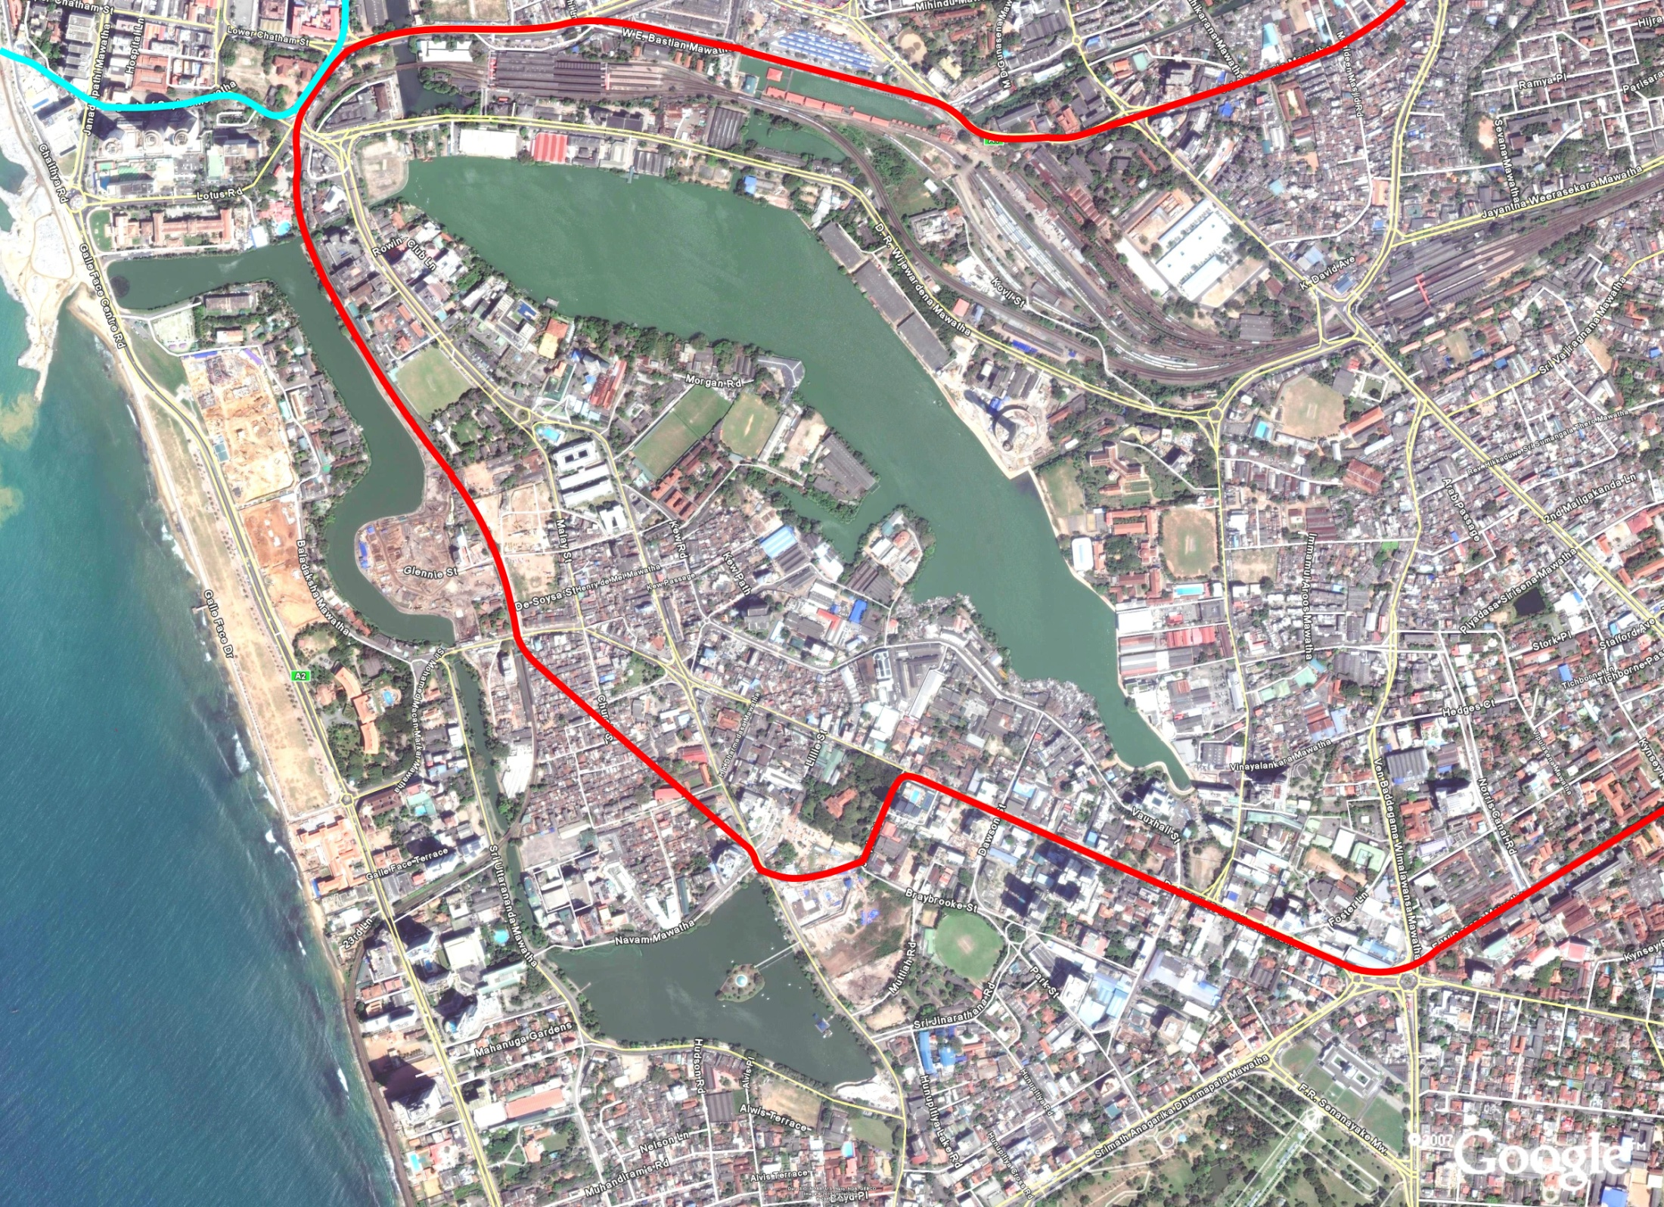
Elevated Rail: Monorail/LRT

Slide 13
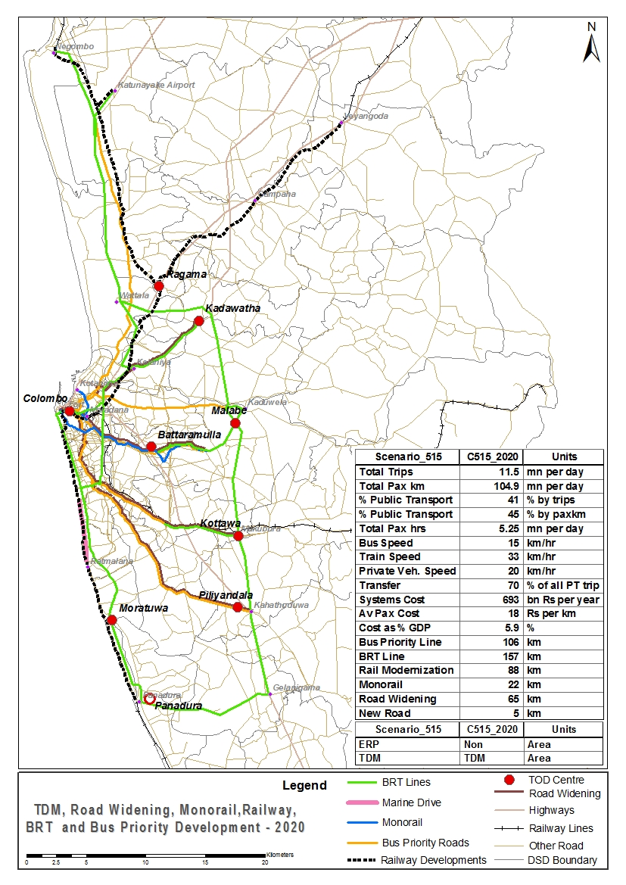
Proposal for Roads
Kandy Road – widening to six lanes up to Kadawatha for BRT
Widening of Low Level Road for Bus
The Land Transport Policy of the Ministry of Transport (2010)
“ensure that at least 1/3rd of existing (and new) road space on major highways within a dense urban area be reserved for high occupancy vehicles….such as bus lanes, LRT or BRT systems”
High Level Road – widening for bus priority
Horana Road – widening for bus priority
Galle Road – new link between Marine Drive and Ratmalana for BRT
Notes:
Dhammika: Animation in one slide for 2020/2025 and 2035
Dhammika: Also thereafter add ERP for 2025 and 2035

Slide 14
Other Supporting Transport Demand Management (TDM)Projects
Rationalize Vehicle Import Taxes
Electronic Road Pricing
Improve Walkability & cycle lanes
Parking Management
Regulation of Hired Vehicles (3 wheelers)
Advanced Traffic/Transport Control System

Slide 15
Financing for Urban Transport Investment Cost (20 years)
Investment across different modes
Total investment for 20 years = Rs 44 bn/yr
Potential Sources of funding
Opportunity of private investment

Slide 16
Closing Thoughts
"An advanced city is not a place where the poor move about in cars, rather it’s where even the rich use public transportation"
Enrique Penalosa (former Mayor of Bogota)
and….Thank You

